Slide 1









Book Marketplace
Intelligence
PRESENTATION 2026
Student Name
Student Email
Guide
Tisha Patni
Nirali Kushwah
tishapatni2006@gmail.com
hakimsinghk4@gmail.com
Jyoti Prajapti

Slide 2

OUTLINE
Abstract of the Project
Problem Statement
Proposed Solution
System Architecture
Live Demo of the Project
Embedded Video of Project
Conclusion
Future Scope

Slide 3
Abstract
Project Scope: Analyzes a cross-platform dataset involving 9 categories and 18
total authors.
Data Volume: Tracks a total of 161 books across platforms like Amazon, Flipkart,
and Books Wagon.
Key Insights: Provides data on total revenue, customer ratings, and platform-specific
performance.

Slide 4

Problem Statement
Market Competition: Difficulty in comparing sales performance across major retailers like Amazon and Flipkart.
Category Trends: Challenges in
identifying which genres (e.g.,
Religious, Thriller, or History) drive the
highest volume.
Demographic Correlation: The need to
connect sales volume with customer
ratings across different generations like
Gen Z and Millennials.

Slide 5

Proposed Solution
Competitive Dashboard:
Aggregates top performers
such as Amish Tripathi and Anita Nair.
Financial Metrics:
Real-time tracking of Total Sales (97K)
versus Total Cost (100K).
Platform Fee Comparison:
Visual breakdown of platform fees and
discounts for Amazon, Flipkart, and
Books Wagon.

Slide 6
System Architecture
Data Inputs
Key Categories
Includes Book Name, Author Name, Platform, and Rating (Bad to Outstanding).
Biography, Drama, Motivational, History, Horror, Poetry, Religious, Romance, Shayari, Thriller and Mystery.
Metrics Engine
Visualization Laye
Calculates maximum and minimum prices across all three integrated platforms.
Features "Revenue by Platform," "Total Sales by Book Genre," and "Books Sold by Year".

Slide 7
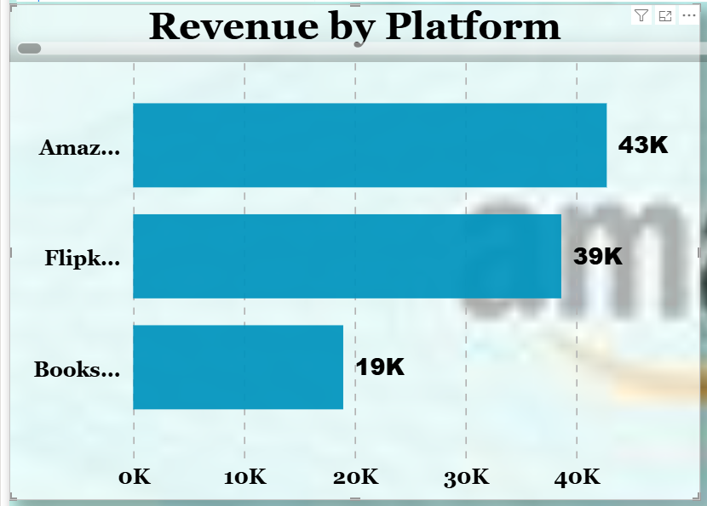
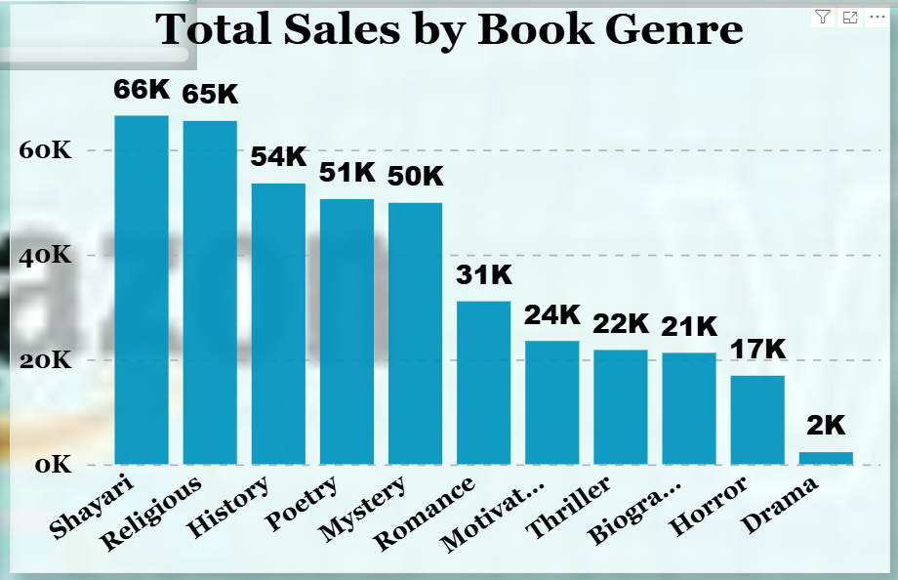
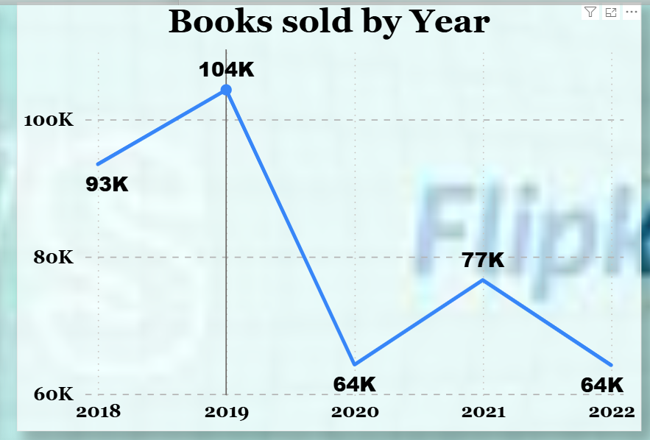
Live Demo of Project
Here’s the list of some demo of the projects -
Revenue by Platform
Total Sales by Book Genre
Books Sold by Year
Amazon earns the most with 43K, Flipkart is next with 39K, and Books wagon has the lowest at 19K. This means Amazon and Flipkart are the main sources of revenue.
Shayari (66K) and Religious (65K) books have the highest sales. History (54K), Poetry (51K), and Mystery (50K) also perform well. Drama has the lowest sales at 2K.
In short: Shayari and Religious genres sell the most, while Drama sells the least.
Sales increased from 93K in 2018 to a peak of 104K in 2019. They dropped sharply to 64K in 2020, rose to 77K in 2021, and fell again to 64K in 2022.
In short: Sales were highest in 2019, lowest in 2020 and 2022, with some recovery in 2021.

Slide 8
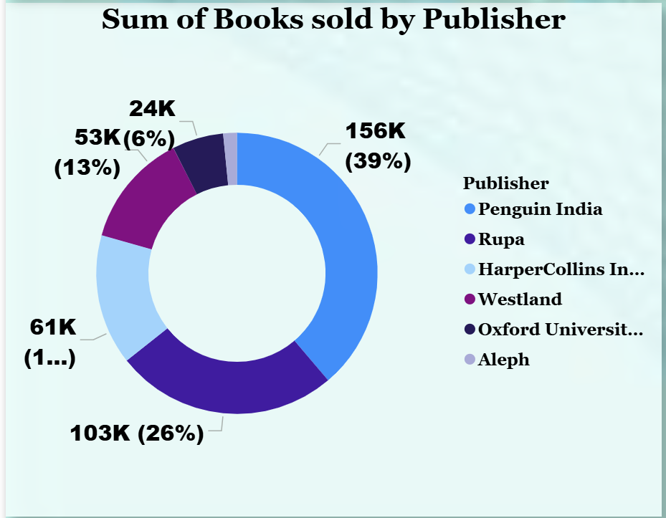
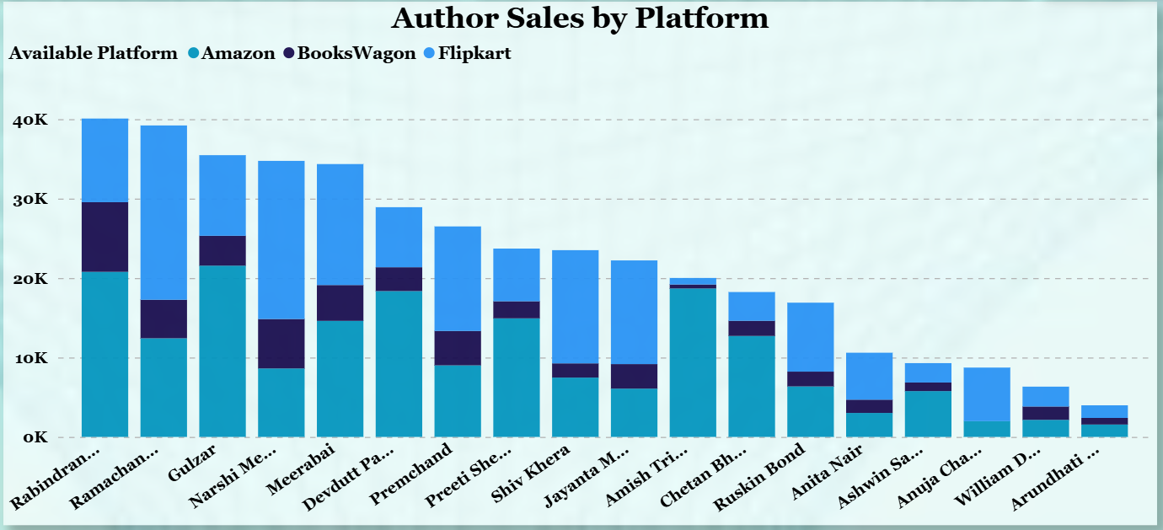
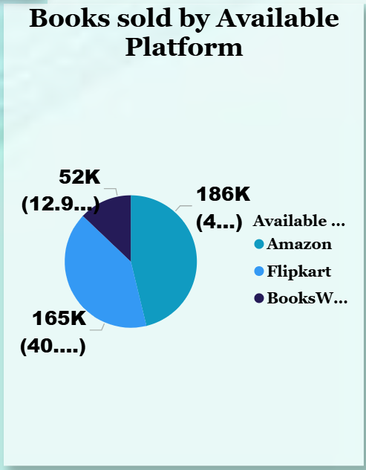
Live Demo of Project
Here’s the list of some demo of the projects -
Sum of Books Sold by Publisher
Author Sales by Platform
Books Sold by Available Platform
Rabindranath Tagore and Ramachandra Guha have the highest overall sales.
For most authors, Amazon and Flipkart contribute more sales than BooksWagon.
Authors like Gulzar, Narsh Mehta, and Devdutt Pattanaik also show strong sales across platforms.
Arundhati Roy and William Dalrymple have the lowest sales in comparison.
Penguin India sells the most books with 156K (39%). Rupa is next with 103K (26%). HarperCollins India has 61K, and Westland has 53K. Oxford University Press and Aleph have the lowest sales at around 24K.
Amazon sells the most books with 186K. Flipkart is close behind with 165K. BooksWagon has the lowest sales at 52K.

Slide 9
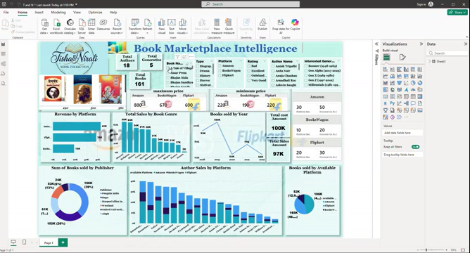
Video of Project Demo

Slide 10

Conclusion
Financial Summary: Total revenue recorded at 97K from a collection of 161 books.
Platform Insights: Amazon remains a dominant platform, with significant sales volume also seen on Flipkart.
Category Leaders: High sales volume identified in genres like Religious, History, and Mystery.

Slide 11

Future Scope
Predictive Analytics: Forecasting future sales based on "Publish Date" and demographic trends.
Author Impact: Deeper analysis into how specific authors influence overall category growth.
Expanded Integration: Incorporating more retailers beyond the current three platforms.

Slide 12
Thank You
Notes:
thank you very much for joining this PPT, keep learning.
12

